Slide 1
THE HUMAN FREEDOM INDEX
Presented By:
1.M.DINESH RAJA-SOLMALAI COLLEGE ENGINEERING-CIVIL

Slide 2
OUTLINE
Problem Statement
Proposed Solution
System Approach
Algorithm & Deployment
Result
Conclusion
Future Scope
References

Slide 3
PROBLEM STATEMENT
The problem statement of human freedom typically revolves around the tension between individual autonomy and societal constraints. It questions how to balance the rights and liberties of individuals with the need for social order and collective well-being. It also delves into issues such as the limits of government intervention, the role of culture and tradition in shaping freedom, and the ethical implications of exercising personal liberty in diverse contexts.

Slide 4
PROPOSED SOLUTION
The proposed solution of a Human Freedom Index involves creating a comprehensive measurement tool that evaluates various aspects of individual freedom within a society. This index typically considers factors such as civil liberties, political rights, rule of law, freedom of expression, economic freedom, and social tolerance. By quantifying these elements, policymakers and researchers can assess the state of freedom in different countries, identify areas for improvement, and track progress over time.

Slide 5
SYSTEM APPROACH
The system approach to the Human Freedom Index involves considering human freedom as a complex system influenced by various interconnected factors. This approach recognizes that individual liberty is affected by political, economic, social, cultural, and legal systems within a society.

Slide 6
ALGORITHM & DEPLOYMENT
Algorithm for Human Freedom Index:
*Define Indicators*: Identify a comprehensive set of indicators that capture different dimensions of human freedom, such as civil liberties, political rights, economic freedom, and social tolerance.
*Data Collection*: Gather relevant data for each indicator from various sources, including surveys, government reports, academic studies, and international organizations.
*Normalization*: Normalize the data to ensure comparability across different indicators and countries. This may involve converting raw data into standardized scores or ranks.

Slide 7
ALGORITHM & DEPLOYMENT
Deployment of Human Freedom Index:
*Website and Database*: Develop a user-friendly website and database where users can access the Human Freedom Index and explore its findings. The website should provide detailed information about the methodology, data sources, and results.
*Interactive Tools*: Include interactive tools and visualizations that allow users to explore the index by country, region, or specific indicators. This could include maps, charts, and data dashboards.
*Policy Briefs*: Create policy briefs and reports based on the index findings to communicate key insights to policymakers, researchers, and the general public. These documents should highlight areas of progress, challenges, and opportunities for promoting human freedom.

Slide 8
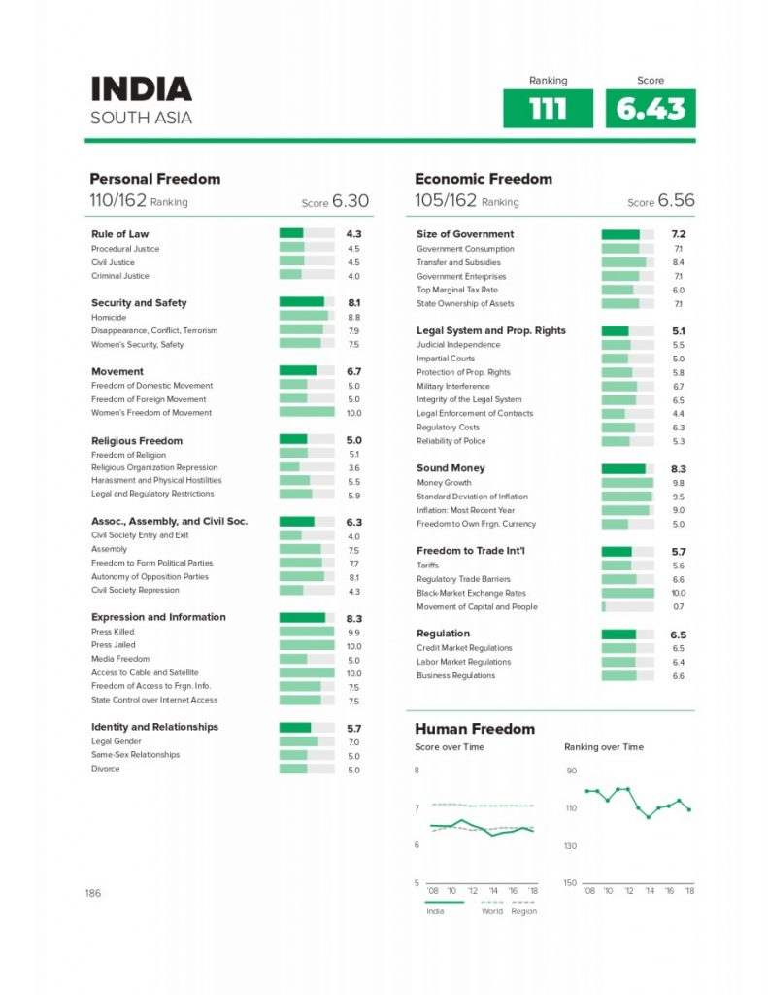
RESULT

Slide 9
COCLUSION
The Human Freedom Index (HFI) typically concludes that human freedom is influenced by various factors including rule of law, personal freedom, economic freedom, and overall governance. The index aims to provide insights into the state of freedom in different countries, highlighting areas of strength and areas needing improvement. The conclusion often emphasizes the importance of protecting and promoting individual liberties and human rights for societal well-being and progress.

Slide 10
FUTURE SCOPE
1. *Expansion of Metrics*: Continuously refining and expanding the metrics used to measure human freedom, considering emerging challenges and changing societal dynamics.
2. *Regional Focus*: Providing more detailed analysis and rankings at regional or local levels to better capture nuances and variations in freedom within countries.
3. *Technological Impact*: Incorporating assessments of how emerging technologies, such as artificial intelligence, surveillance systems, and biometric identification, affect human freedom.

Slide 11
REFERENCE
https://www.kaggle.com/datasets/afumetto/3dprinter

Slide 12
THANKYOU

